Slide 1
MOVIE TICKET BOOKING MANAGEMENT SYSTEM
Team members:-
Abhijith Suresh (Team Lead) Dona Binu
Daniel Pavun Raj R Sabari Sundar A R
Sudharsen R J

Slide 2
INTRODUCTION
This project is a standalone and modular cinema booking system designed to streamline the management of movies, showtimes, customers, and ticket bookings.
It integrates multiple functional modules that work together to provide a seamless experience for both administrators and customers.
Key Features:
Modular architecture with interlinked components
Efficient management of movie listings, show schedules, customer data, and ticket bookings
Historical tracking of customer bookings
Implementation using Java Collections for dynamic data handling (e.g., ArrayList, HashMap, etc.)

Slide 3
OBJECTIVE
Develop a modular and efficient system for managing cinema operations using Java Collections Framework.
Simplify the booking process for customers while providing administrators with tools to manage movies, showtimes, and customer data.
Ensure seamless data flow between modules through shared identifiers (movieId, showId, etc.).
Enable quick access to reports and booking history, improving operational transparency and customer service.

Slide 4
ABOUT THE PROJECT
The project is a Standalone and Modular Movie Ticket Booking System designed to manage cinema operations digitally.
It automates movie scheduling, showtime management, customer registration, and ticket booking processes.
The system is divided into five main modules — Movie Management, Showtime Management, Customer Management, Ticket Booking, and Booking History.
All modules are interconnected through shared data identifiers like movieId, showId, and customerId.

Slide 5
ABOUT THE PROJECT
It provides two user interfaces — one for Admins and one for Customers for efficient role-based operations.
Admins can manage movies, showtimes, and users, and monitor all ticket bookings.
Users can browse available movies, book tickets, and view their personal booking history.
The system ensures data consistency, accuracy, and easy access to information across all modules.
Built with a modular and scalable architecture, making it easy to maintain and expand in the future.
The main goal is to provide a user-friendly, efficient, and automated solution for movie ticket management.

Slide 6
PROJECT DETAILS
The Online Movie Ticket Booking System aims to manage all aspects of movie showtimes, customer details, and ticket bookings, while offering administrators full control over content and data. It offers the following features:
1. Movie Management:
Admins can add, edit, and remove movies from the system.
Each movie is defined by essential attributes such as movieId, title, genre, duration, and language.
Enables categorization of movies for easy browsing by users.
2. Showtime Management:
Admins can add and manage showtimes for each movie, specifying the showId, movieId, date, and time.
Allows the scheduling of multiple showtimes for a movie, making it convenient for users to select their preferred timing.

Slide 7
PROJECT DETAILS
3. Customer Management:
Admins can add, view, and delete customer profiles with details such as customerId, name, email, and phone.
Ensures a complete record of each customer.
4. Ticket Booking:
Customers can select a movie and book tickets for a specific showtime by choosing the number of seats.
Each booking is tied to a unique ticketId, customerId, and showId, allowing for easy tracking.
Admins can view all booked tickets, ensuring the availability of accurate data for showtimes and seat occupancy.

Slide 8
PROJECT DETAILS
5. Booking History:
Customers can view their past bookings including the details of tickets booked for each showtime.
Helps users track their movie-going experiences and manage future bookings.
6. User and Admin Interfaces:
Admins have special functionalities to manage movies, showtimes, customers, and bookings.
Users (customers) can browse movies, book tickets, and track their booking history.

Slide 9
MAJOR MODULES
Movie Management – Centralized control to add, update, and view movie details including genre, duration, and language.
Showtime Management – Organizes scheduling of movies with date and time, ensuring smooth coordination across theaters.
Customer Management – Maintains customer profiles and contact information for personalized service and tracking.
Ticket Booking & History – Enables seamless ticket reservations, seat allocation, and provides complete booking history for users and admins.

Slide 10
ROLES
Abhijith Suresh (Team Lead)- Implemented the Movie Ticket booking system module, added separate interface for admin and normal users in UI
Dona Binu (Team Member)- Implemented the customer purchase history module and also created the UI.
Daniel Pavun Raj R (Team Member)- Implemented the Showtime management modules for movies.
Sabari Sundar A R (Team Member)- Implemented the Customer management module.
Sudharsen R J (Team Member) – Implemented the Movie management module.

Slide 11
DURATION OF THE PROJECT
Start Date & Time:
4th November 2025 at 2:00 PM
Development Completion:
4th November 2025 at 7:00 PM
Integration Phase:
5th November 2025 from 9:00 AM to 10:00 AM
Total Duration:
6 hours (including development and integration)

Slide 12
APPROACH
Our development approach for the Cinema Booking System focused on modularity, simplicity, and efficient data handling using Java. Here's how we structured it:
1. Modular Design:
Divided the system into five core modules:
Movie Management
Showtime Management
Customer Management
Ticket Booking
Booking History
Each module handles specific responsibilities and interacts with others through shared identifiers (movieId, showId, etc.).
2. Java Collections Framework:
Used ArrayList, HashMap, and other collection classes to store and manage dynamic data.
Enabled fast access, insertion, and retrieval of records without using external databases.

Slide 13
APPROACH
3. Data Interlinking:
Maintained relationships between entities (e.g., movies and showtimes, customers and bookings) using unique IDs.
Ensured consistency and traceability across modules.
4. Console-Based Interaction:
Implemented a simple console-based interface for input/output operations.
Focused on functionality and logic over UI for clarity and ease of testing.

Slide 14
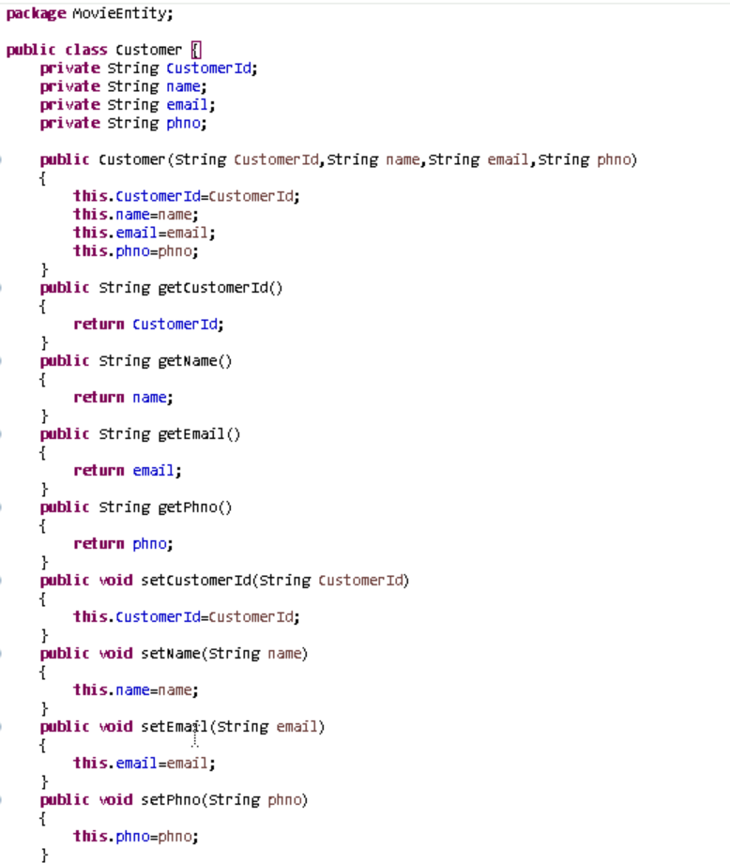
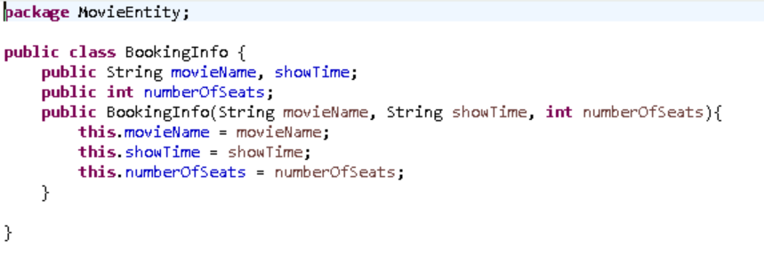
SCREENSHOTS
Customer Entity
BookInfo Entity

Slide 15
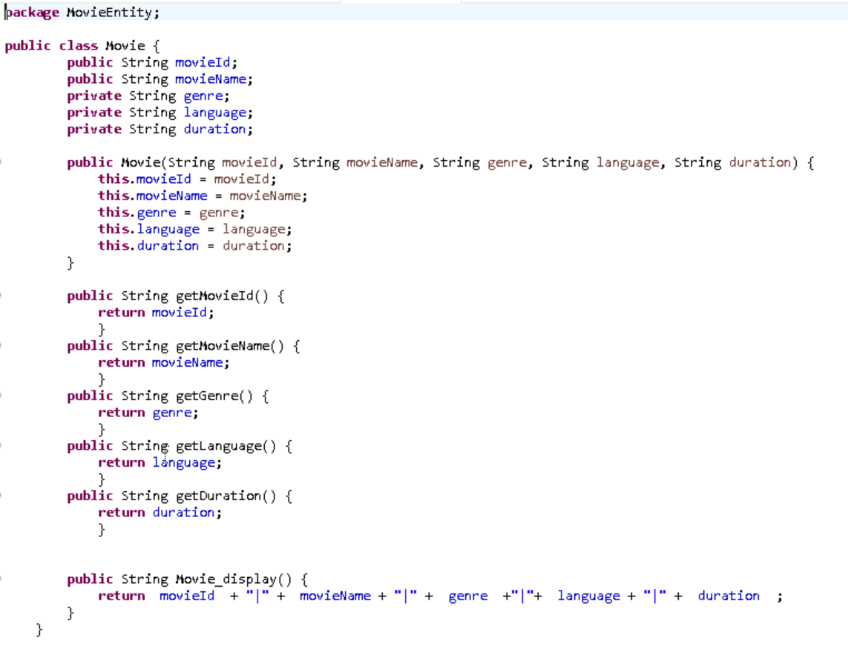
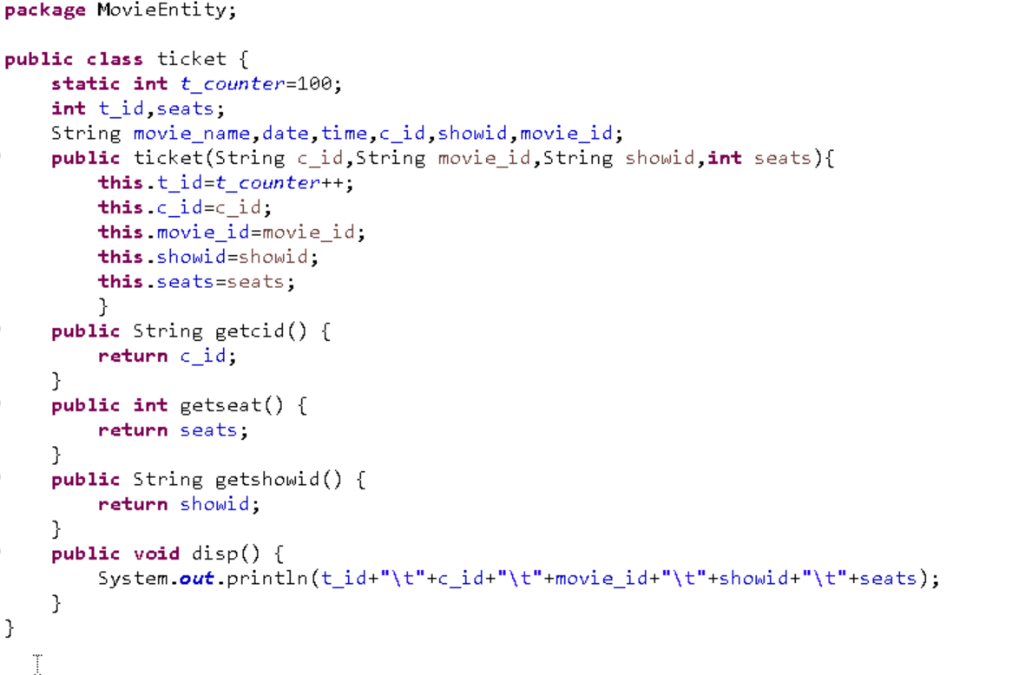
SCREENSHOTS
Movie Entity
Ticket Entity

Slide 16
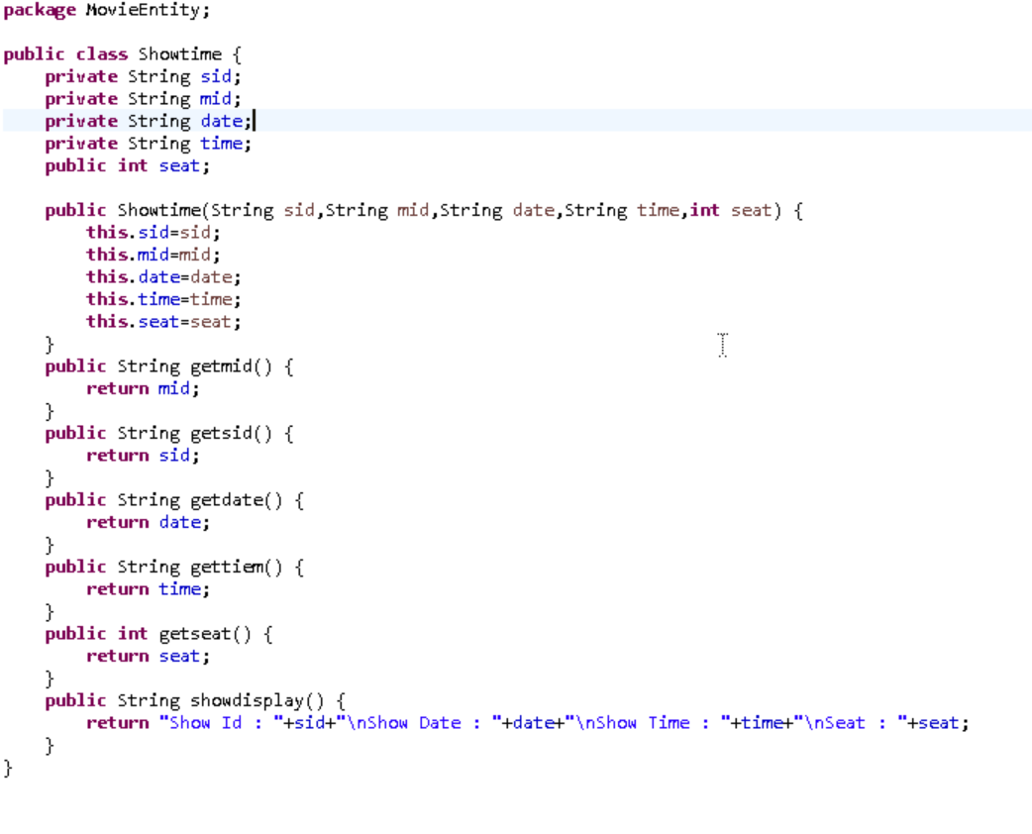
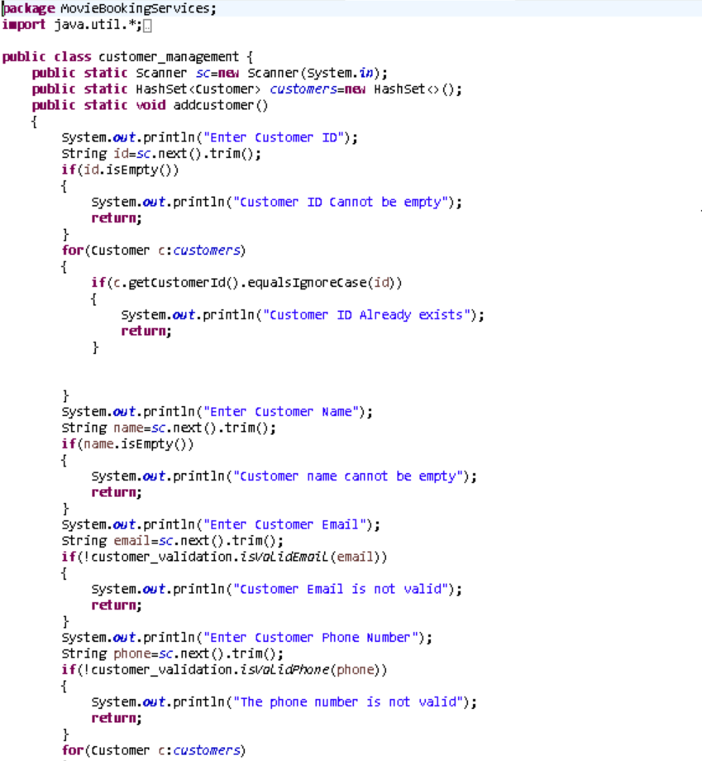
SCREENSHOTS
Showtime Entity
Customer management service

Slide 17
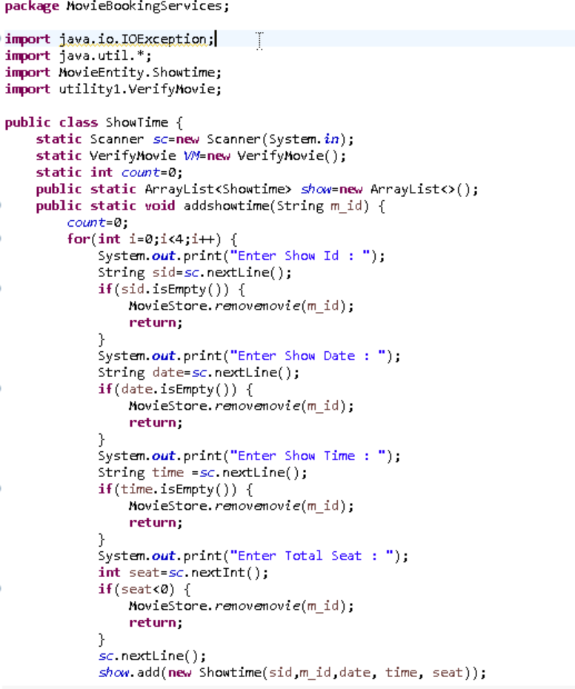
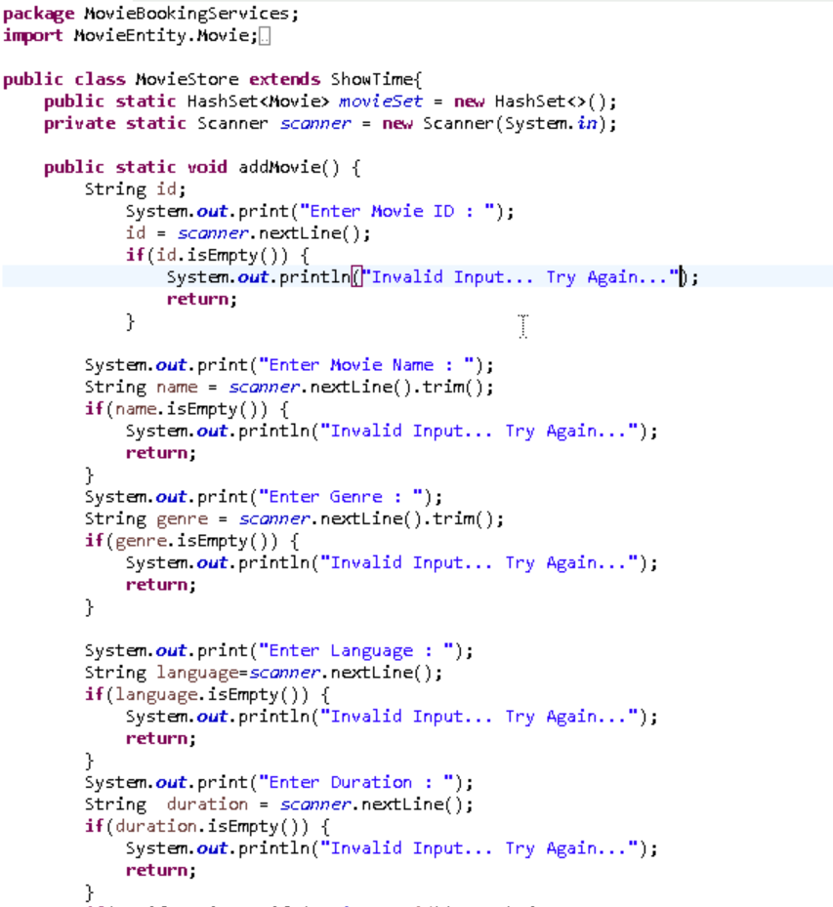
SCREENSHOTS
Movie management service
Showtime management service

Slide 18
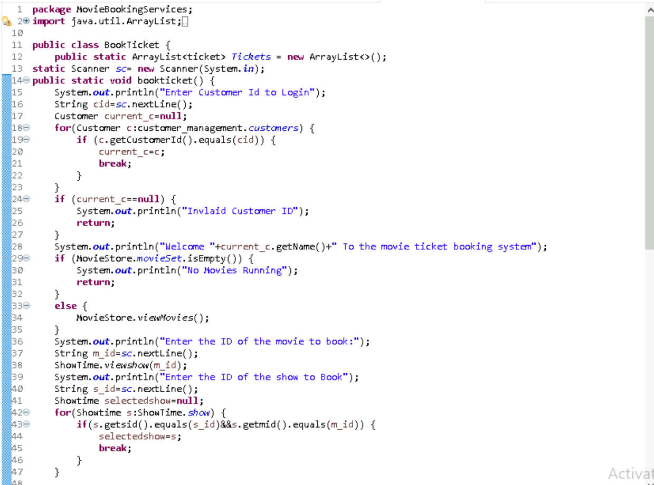
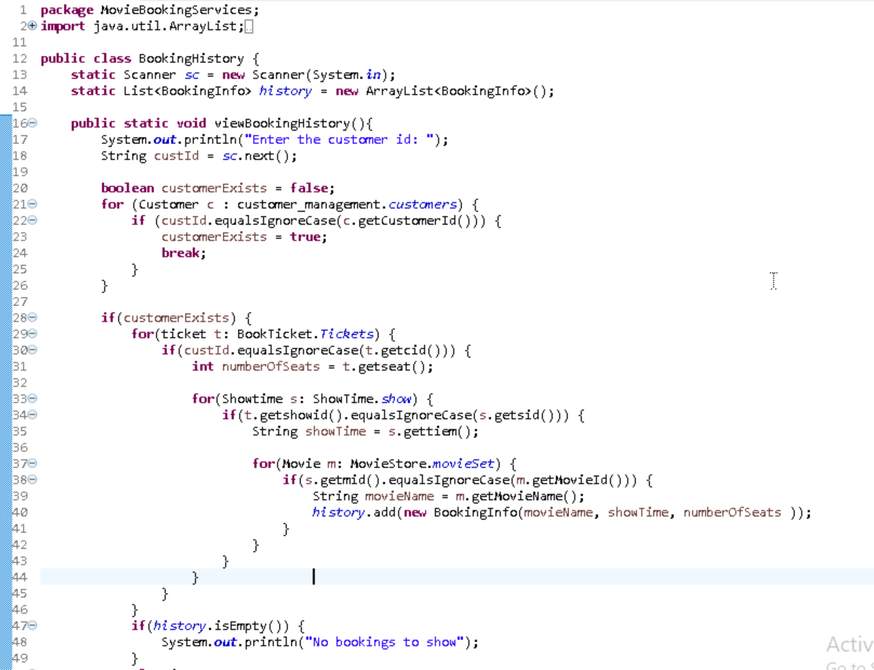
SCREENSHOTS
Ticket booking service
Booking History service

Slide 19
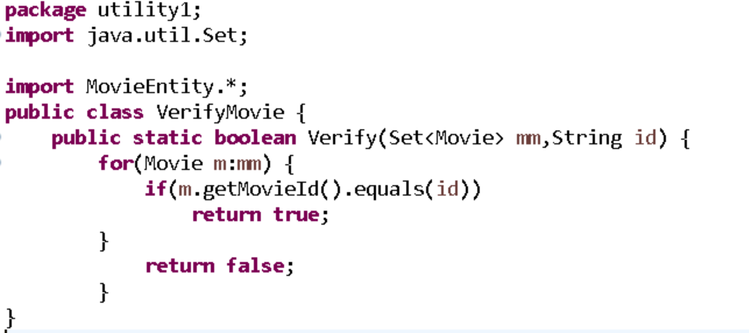
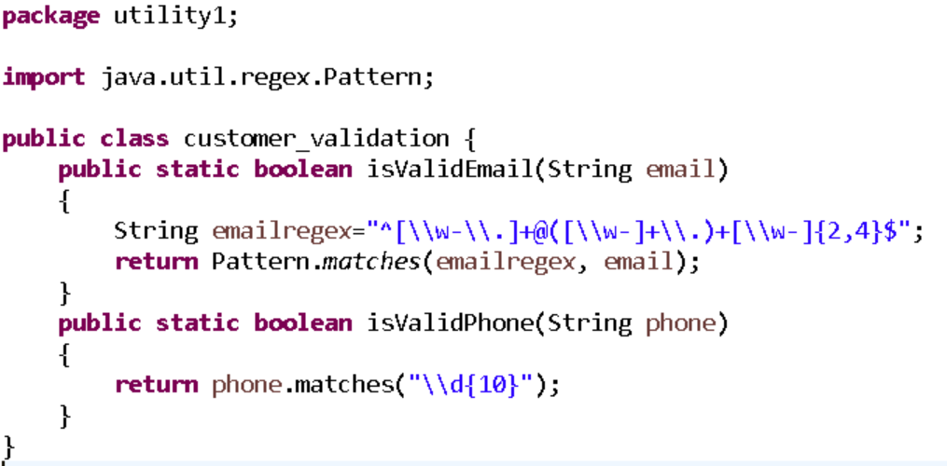
SCREENSHOTS
Movie Validation
Customer validation

Slide 20
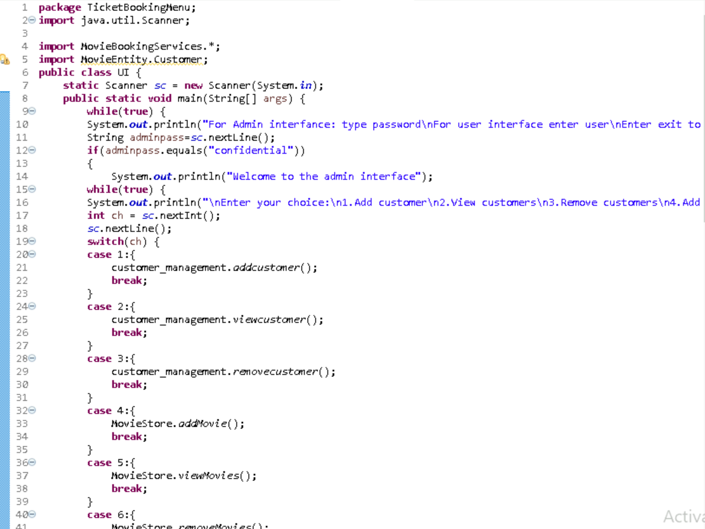
SCREENSHOTS
User Interface

Slide 21
SCREENSHOTS
User Interface

Slide 22
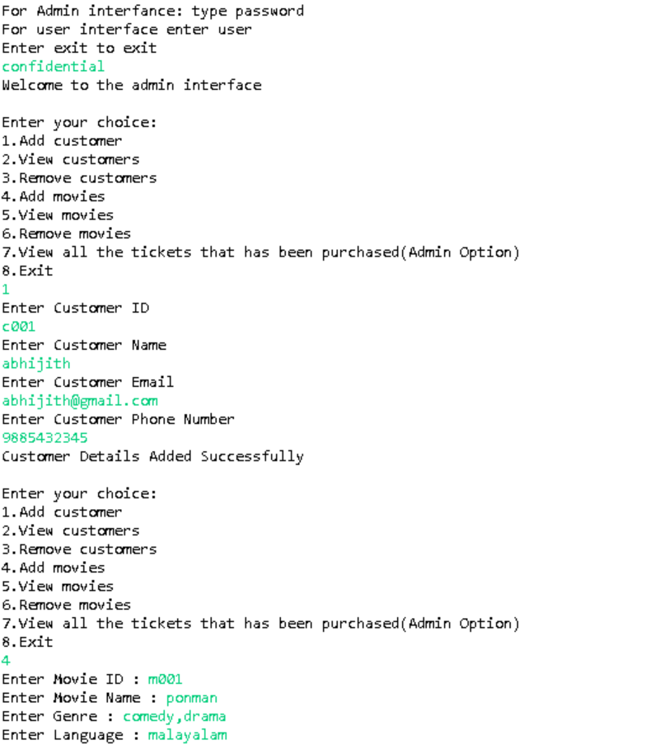
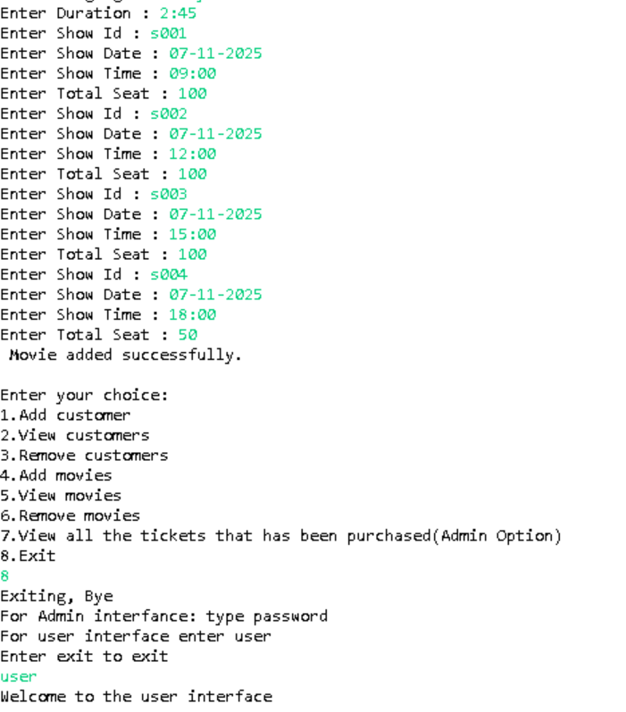
SCREENSHOTS
OUTPUT

Slide 23
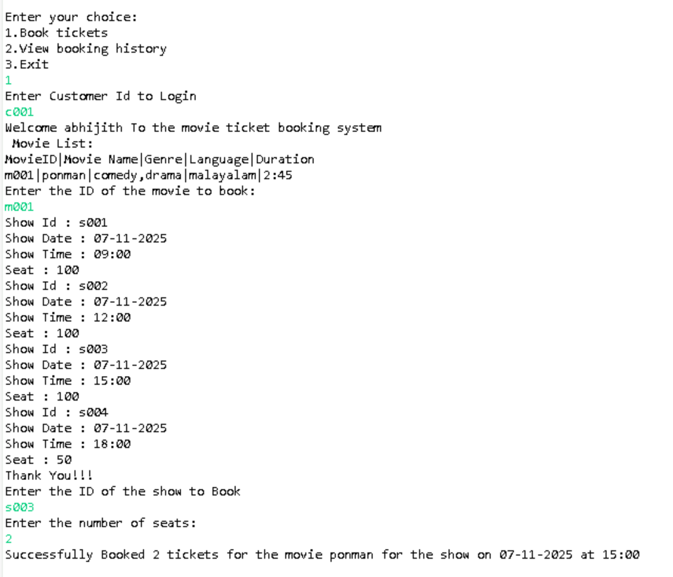
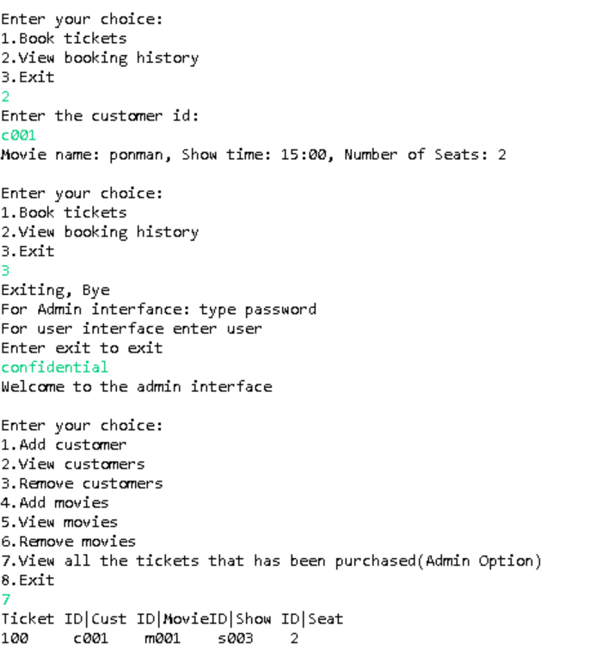
SCREENSHOTS
OUTPUT

Slide 24
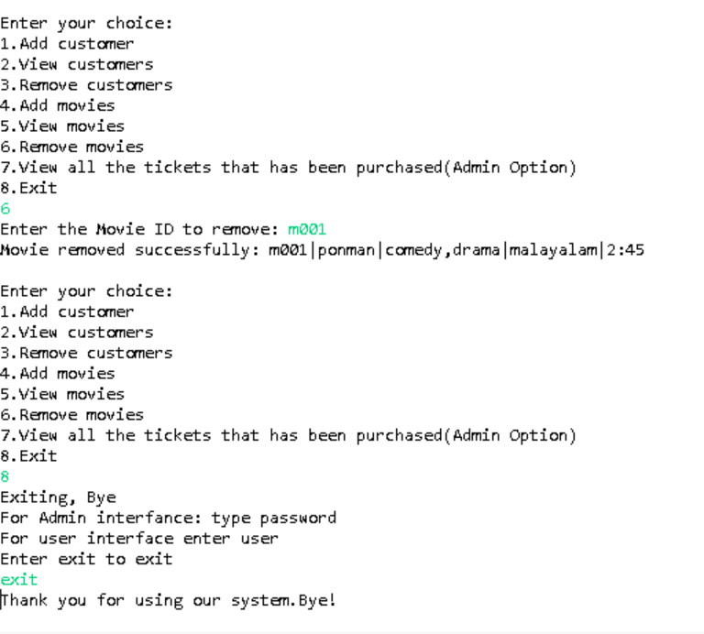
SCREENSHOTS
OUTPUT

Slide 25
REPORTS
The Cinema Booking System provides basic reporting capabilities to help track and manage system data effectively:
1. Movie Reports:
List of all movies currently available
Details include: movieId, title, genre, duration, language
2. Showtime Reports:
Overview of scheduled showtimes
Includes: showId, movieId, date, time
3. Customer Reports:
Complete customer list with contact details
Includes: customerId, name, email, phone

Slide 26
REPORTS
4. Booking Reports:
Summary of all ticket bookings
Includes: ticketId, customerId, showId, numberOfSeats
5. Booking History Reports:
View past bookings made by each customer
Useful for tracking customer activity and preferences

Slide 27
CONCLUSION
The Online Movie Ticket Booking System successfully delivers a fully integrated platform, effectively linking Movie Management, Showtime Scheduling, Customer Registration, and Ticket Booking. By establishing robust data relationships (e.g., movieId, showId), the system streamlines complex administrative operations while simultaneously providing distinct, intuitive interfaces for both Admins and Customers. This design ensures enhanced security and a simplified ticket purchasing process, proving the system's viability for efficient and accurate transaction management.
Future Scope
Seat Selection:
Introduce a graphical interface for specific seat selection (e.g., A1, B5) instead of just the number of seats.

